Slide 1
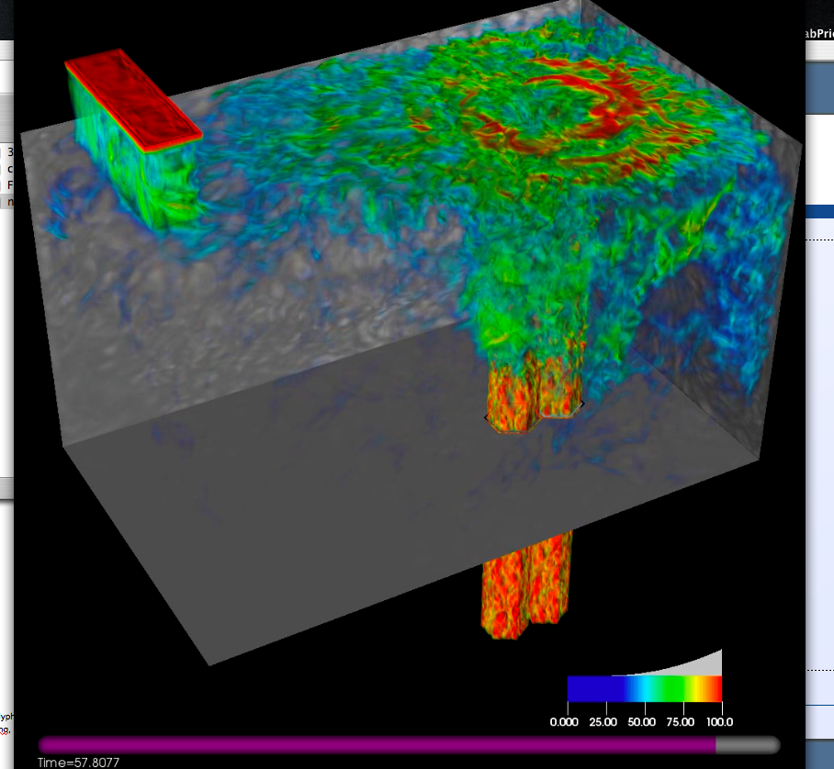
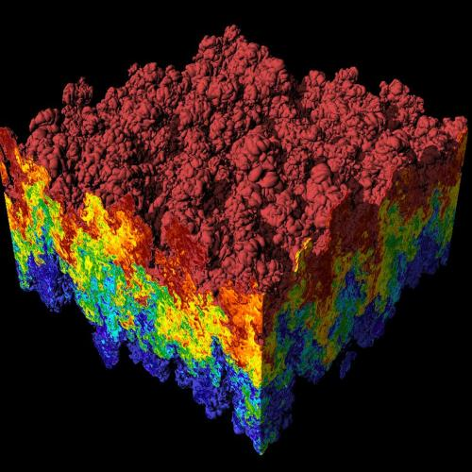
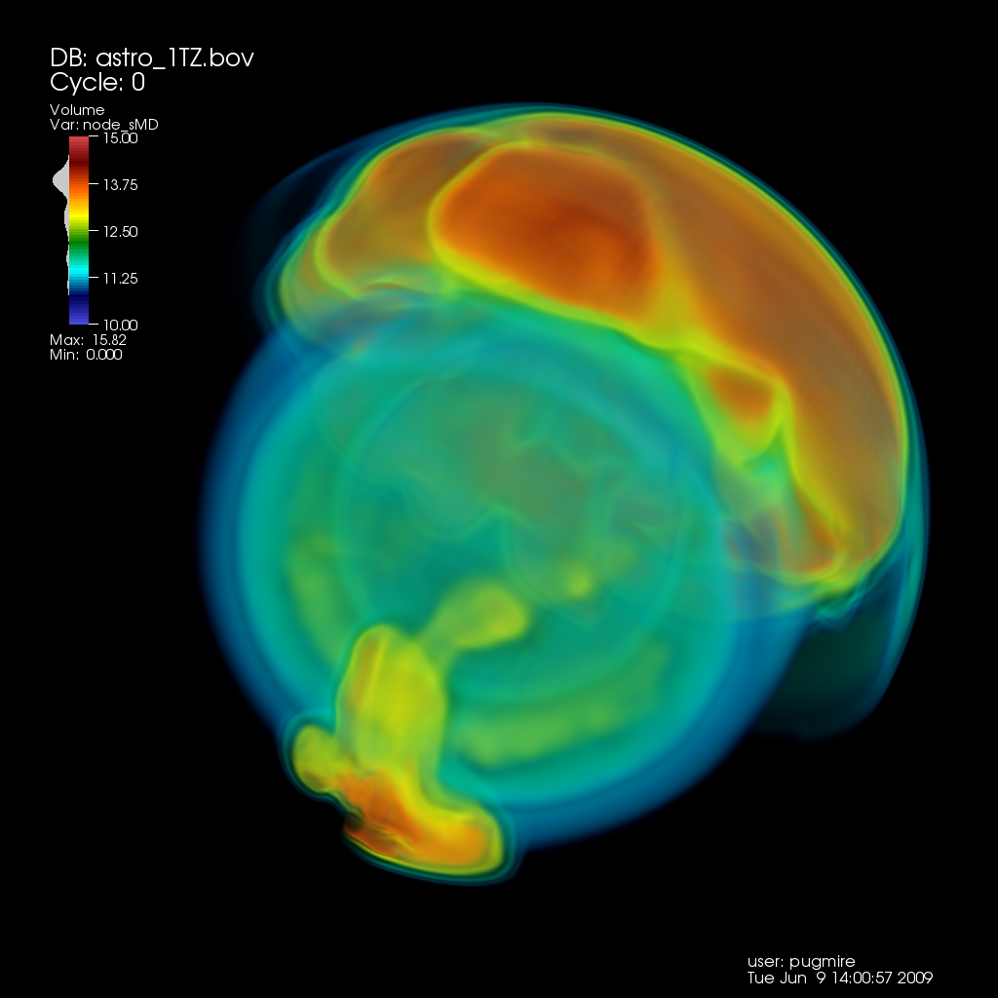
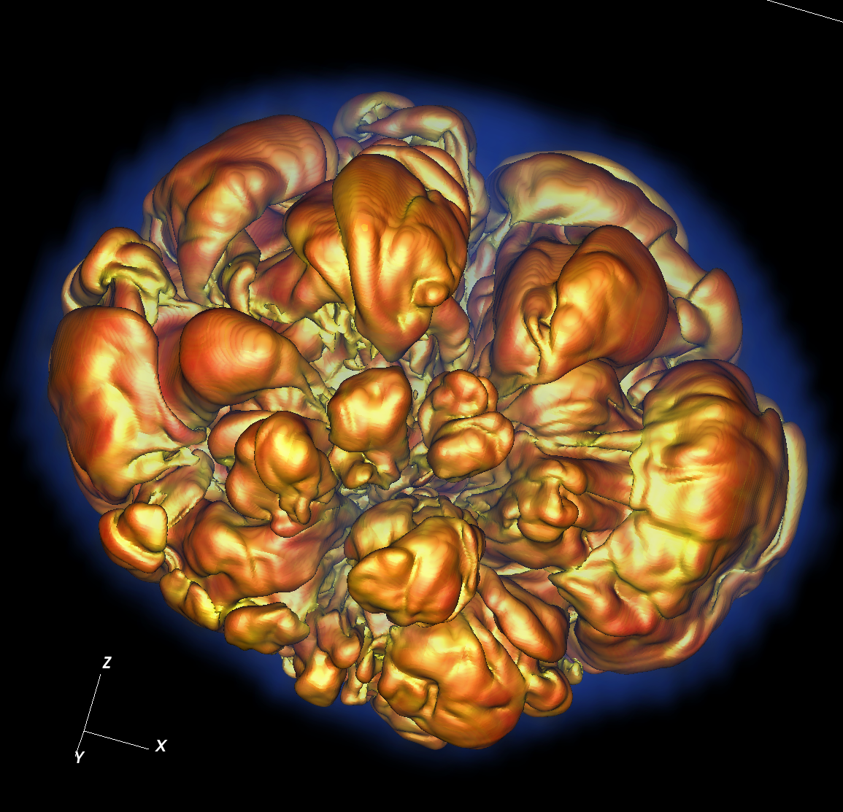
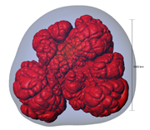
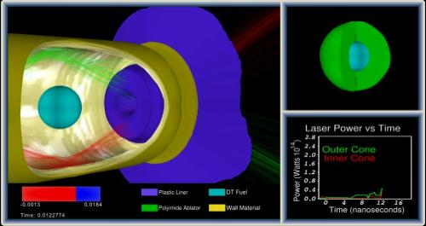
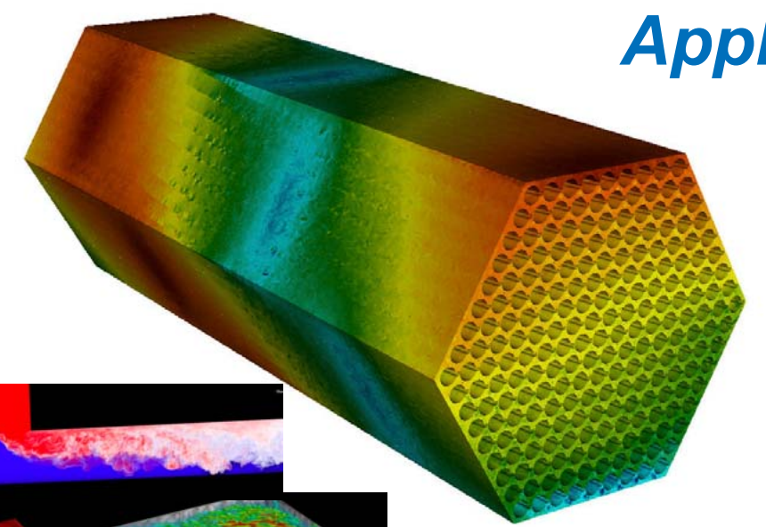
CIS 441/541: Introduction to Computer Graphics Lecture 15: shaders
March 12th, 2019
Hank Childs, University of Oregon

Slide 2
Talk _more_ about the test

Slide 3
Project G
Blender
WebGL #1
WebGL #2
CUDA
Bezier
Computer Vision
Shaders

Slide 4
Schedule
Upcoming:
Today: shaders, live code
Thursday: test re-take

Slide 5
Late Passes
Will bring forms to final

Slide 6
Hank OH
Primary purpose of Hank’s OH is now to help with self-defined projects
Also can help with 1A-1F,2A,2B
Friday OH: 11am-12noon

Slide 7
Final Presentations
3 minutes each
Make sure to make it clear what you did
Try to impress judges
What is cool about what you did?
Format
PowerPoint
Demo
PowerPoint + Demo
Connect A/V to Rm 220 project before 9am as test

Slide 8
Shaders

Slide 9
Shaders
Shader: computer program used to do “shading”
“Shading”: general term that covers more than just shading/lighting
Used for many special effects
Increased control over:
position, hue, saturation, brightness, contrast
For:
pixels, vertices, textures

Slide 10
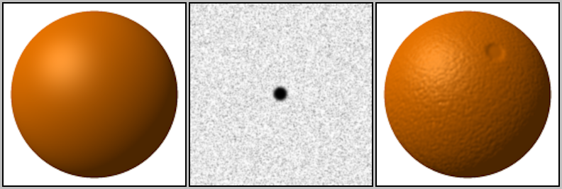
Motivation: Bump Mapping
Idea:
typical rasterization, calculate fragments
fragments have normals (as per usual)
also interpolate texture on geometry & fragments
use texture for “bumps”
take normal for fragment and displace it by “bump” from texture
image from wikipedia

Slide 11
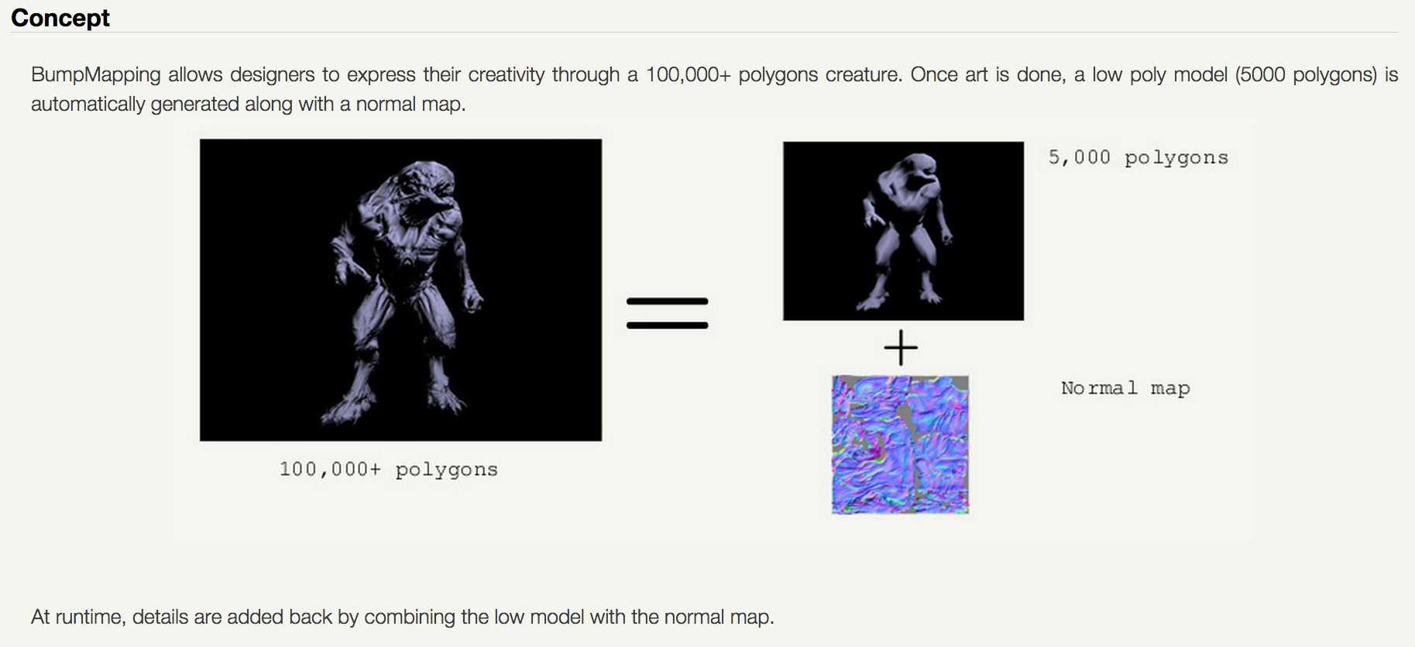
Bump Mapping Example
credit: http://www.fabiensanglard.net/bumpMapping/

Slide 12
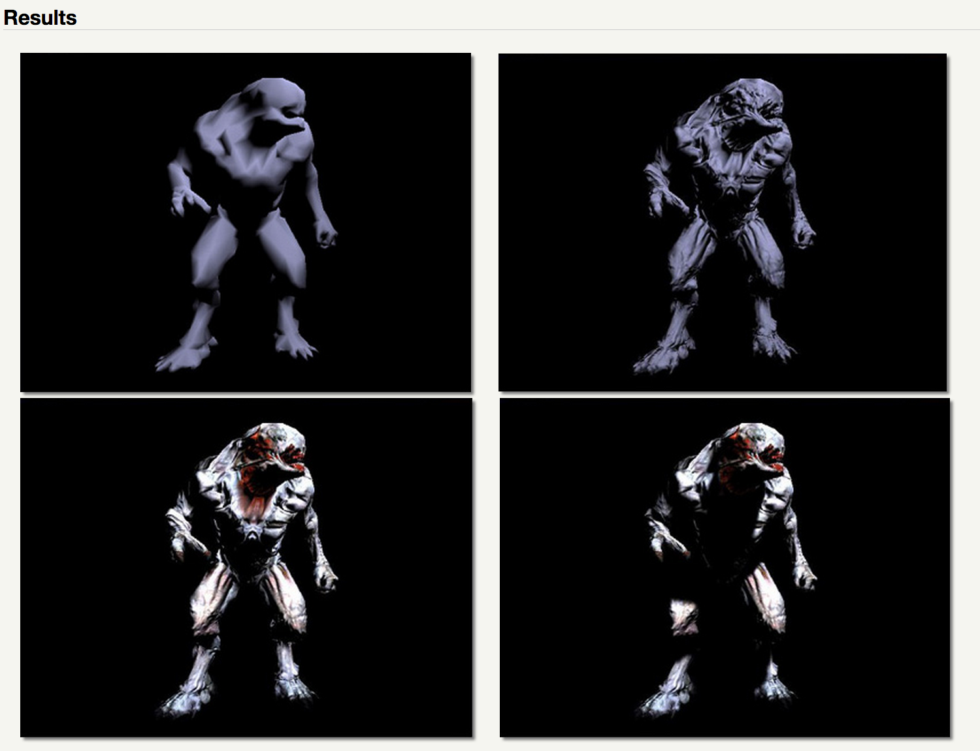
Bump Mapping Example

Slide 13
How to do Bump Mapping?
Answer: easy to imagine doing it in your Project 1A-1F infrastructure
You have total control
But what OpenGL commands would do this?
Not possible in V1 of the GL interface, which is what we have learned
It is possible with various extensions to OpenGL
We will learn to do this with shaders

Slide 14
Shading Languages
shading language: programming language for graphics, specifically shader effects
Benefits: increased flexibility with rendering
OpenGL (as we know it so far): fixed transformations for color, position, of pixels, vertices, and textures.
Shader languages: custom programs, custom effects for color, position of pixels, vertices, and textures.

Slide 15
ARB assembly language
ARB: low-level shading language
at same level as assembly language
Created by OpenGL Architecture Review Board (ARB)
Goal: standardize instructions for controlling GPU
Implemented as a series of extensions to OpenGL
You don’t want to work at this level, but it was an important development in terms of establishing foundation for today’s technology

Slide 16
GLSL: OpenGL Shading Language
GLSL: high-level shading language
also called GLSLang
syntax similar to C
Purpose: increased control of graphics pipeline for developers, but easier than assembly
This is layer where developers do things like “bump mapping”
Benefits:
Benefits of GL (cross platform: Windows, Mac, Linux)
Support over GPUs (NVIDIA, ATI)
HW vendors support GLSL very well

Slide 17
Other high-level shading languages
Cg (C for Graphics)
based on C programming language
outputs DirectX or OpenGL shader programs
deprecated in 2012
HLSL (high-level shading language)
used with MicroSoft Direct3D
analogous to GLSL
similar to CG
RSL (Renderman Shading Language)
C-like syntax
for use with Renderman: Pixar’s rendering engine

Slide 18
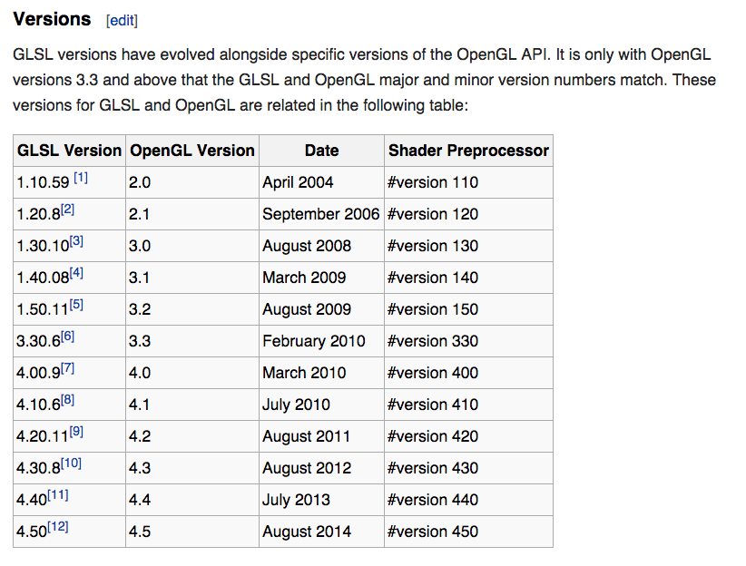
Relationship between GLSL and OpenGL
Source: wikipedia

Slide 19
4 Types of Shaders
Vertex Shaders
Fragment Shaders
Geometry Shaders
Tessellation Shaders
It is common to use multiple types of shaders in a program and have them interact.

Slide 20
How Shaders Fit Into the Graphics Pipeline
You can have 0 or 1 of each shader type
Vertex & fragment: very common
Geometry & tessellation: less common
adaptive meshing
Transform Vertices from World Space to Device Space
Rasterize
Contribute Fragments to Buffers
vertex shaders: custom implementation
fragment shaders: custom implementation
geometry & tessellation shaders: create new geometry before rasterized

Slide 21
Vertex Shader
Run once for each vertex
Can: manipulate position, color, texture
Cannot: create new vertices
Primary purpose: transform from world-space to device-space (+ depth for z-buffer).
However: A vertex shader replaces the transformation, texture coordinate generation and lighting parts of OpenGL, and it also adds texture access at the vertex level
Output goes to geometry shader or rasterizer

Slide 22
Geometry Shader
Run once for each geometry primitive
Purpose: create new geometry from existing geometry.
Output goes to rasterizer
Examples: glyphing, mesh complexity modification
Formally available in GL 3.2, but previously available in 2.0+ with extensions
Tessellation Shader: doing some of the same things
Available in GL 4.0

Slide 23
Fragment Shader
Run once for each fragment
Purpose: replaces the OpenGL 1.4 fixed-function texturing, color sum and fog stages
Output goes to buffers
Example usages: bump mapping, shadows, specular highlights
Can be very complicated: can sample surrounding pixels and use their values (blur, edge detection)
Also called pixel shaders

Slide 24
How to Use Shaders
You write a shader program: a tiny C-like program
You write C/C++ code for your application
Your application loads the shader program from a text file
Your application sends the shader program to the OpenGL library and directs the OpenGL library to compile the shader program
If successful, the resulting GPU code can be attached to your (running) application and used
It will then supplant the built-in GL operations

Slide 25
How to Use Shaders: Visual Version
sends “char *”
version of
program to GL via
function call
Project2B’
C++ code
Project2B’
binary
g++
OpenGL
library
reads
text
file
when
running
OpenGL
compiles program, binary made just for
the current
execution
Program is used
on GPU to support
Project2B’ binary
shader program is a binary
shader program

Slide 26
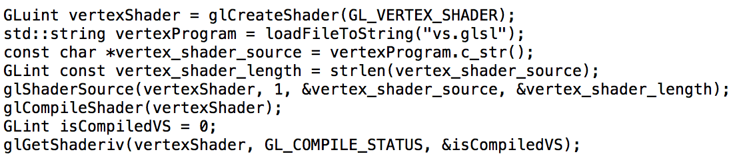
Compiling Shader

Slide 27
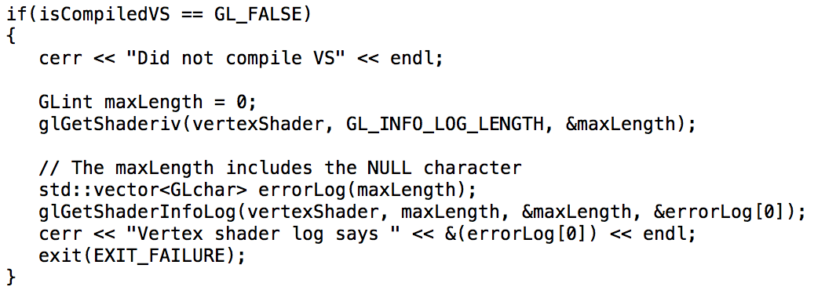
Compiling Shader: inspect if it works

Slide 28
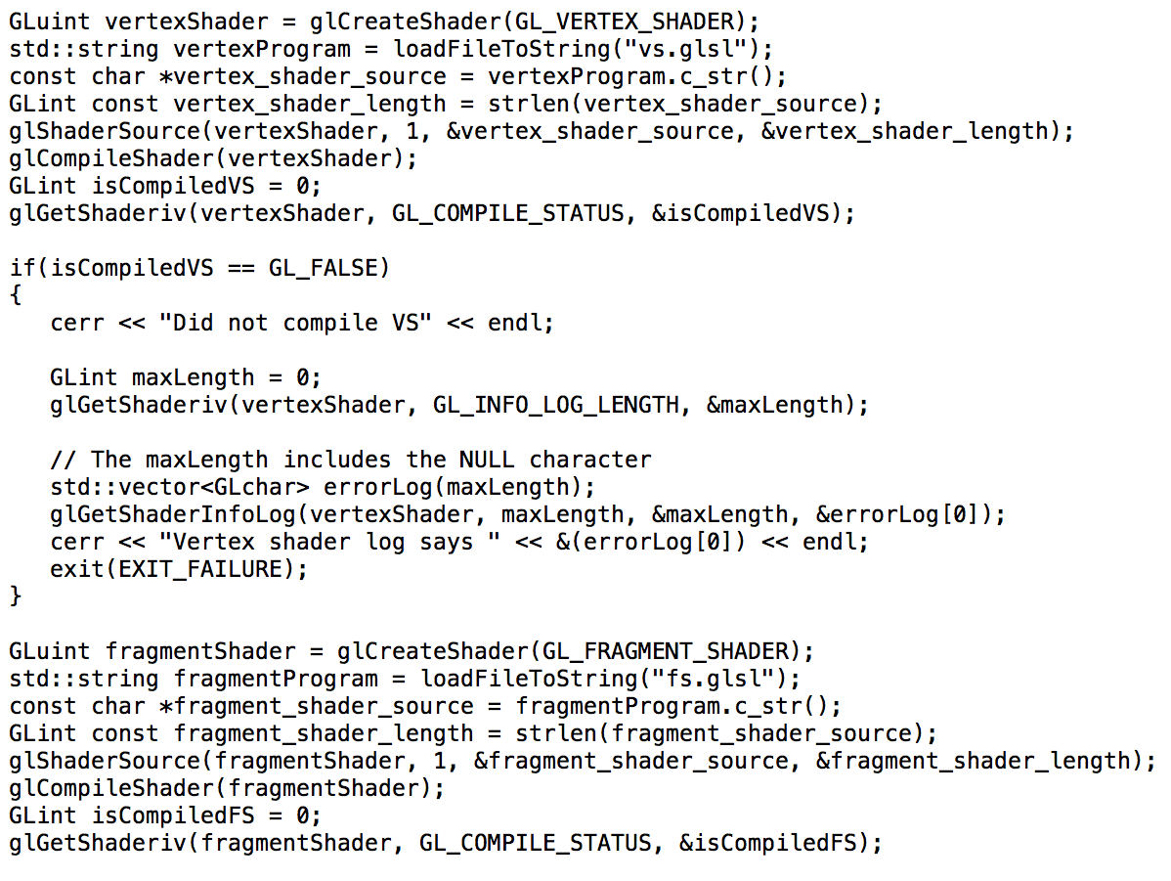
Compiling Multiple Shaders

Slide 29
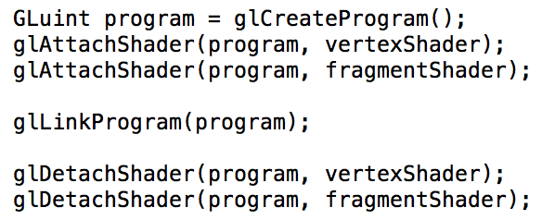
Attaching Shaders to a Program

Slide 30
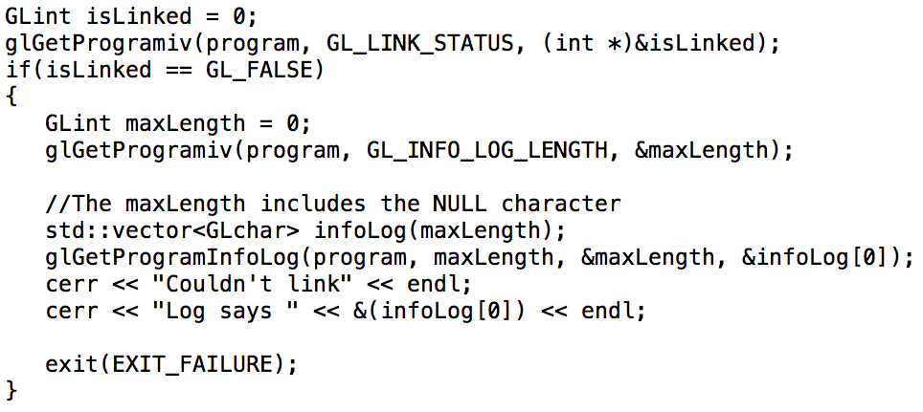
Inspecting if program link worked…

Slide 31
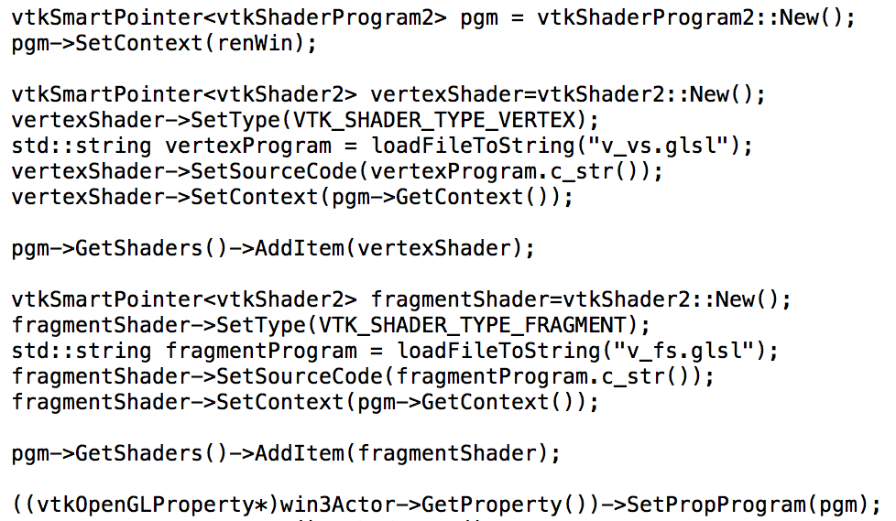
BUT: this doesn’t work in VTK…
VTK has its own shader handling, and it doesn’t play well with the GL calls above…
note: VTK6.1 much better for shaders than 6.0

Slide 32
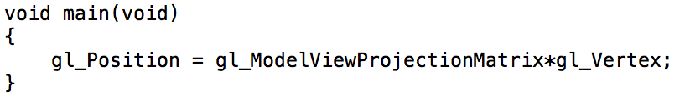
Simplest Vertex Shader
Many built-in variables.
Some are input.
Some are required output (gl_Position).

Slide 33
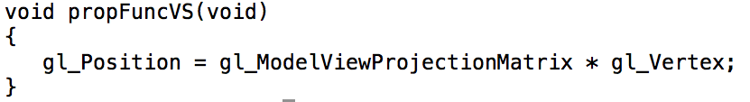
Simplest Vertex Shader (VTK version)
VTK uses special names
propFuncVS: vertex shader
propFuncFS: fragment shader
somehow it changes these into “main” just in time…

Slide 34
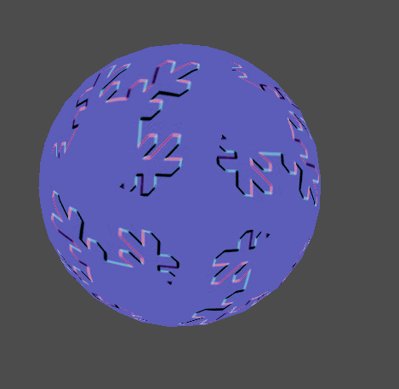
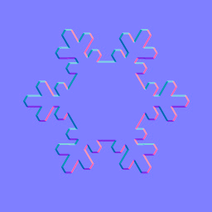
Bump-mapping with GLSL
bump map texture
output

Slide 35
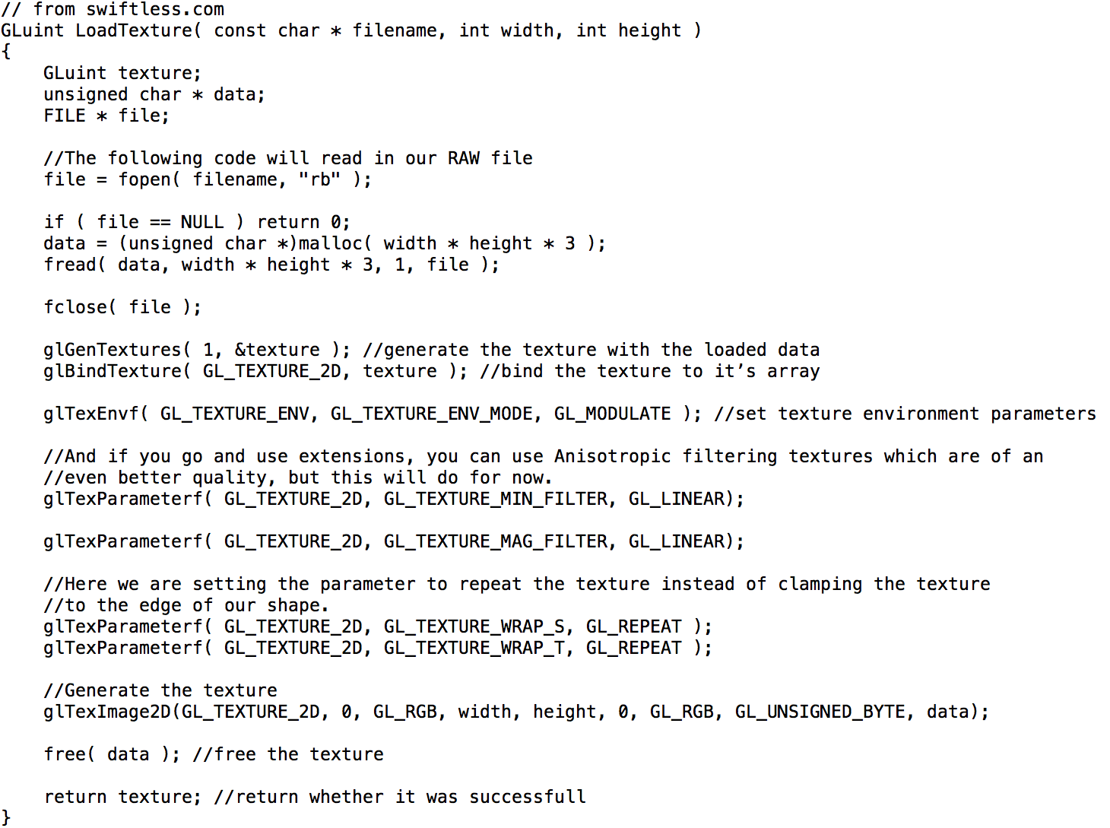
Will need to load a texture…

Slide 36
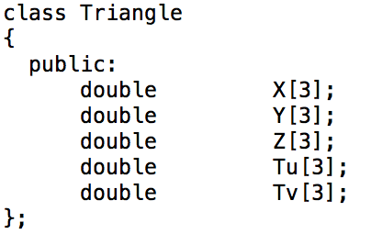
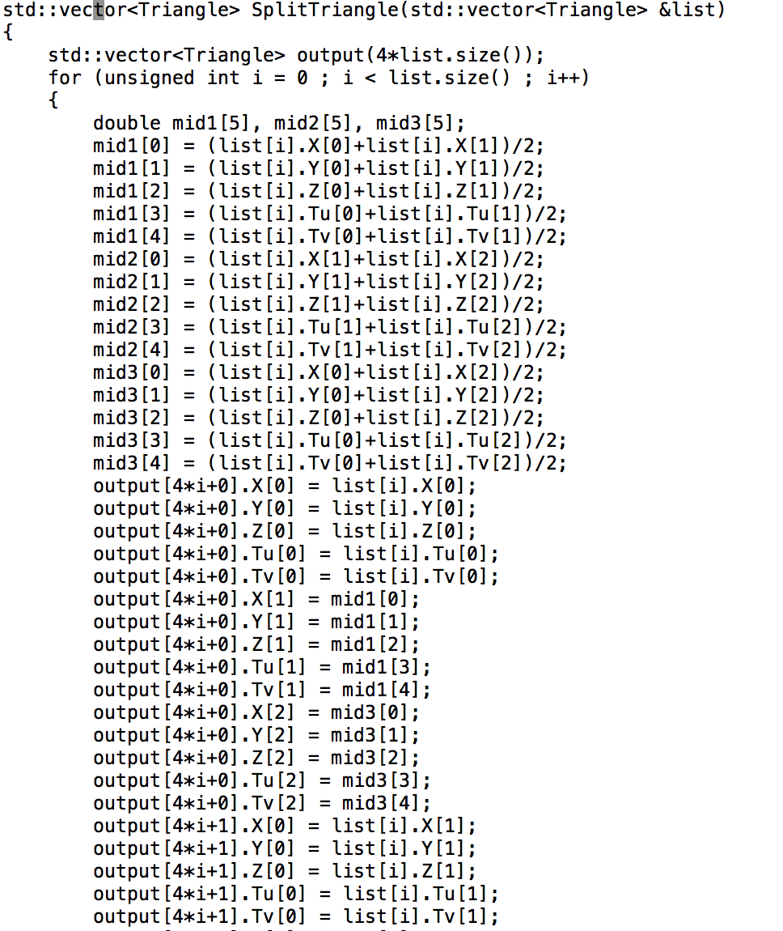
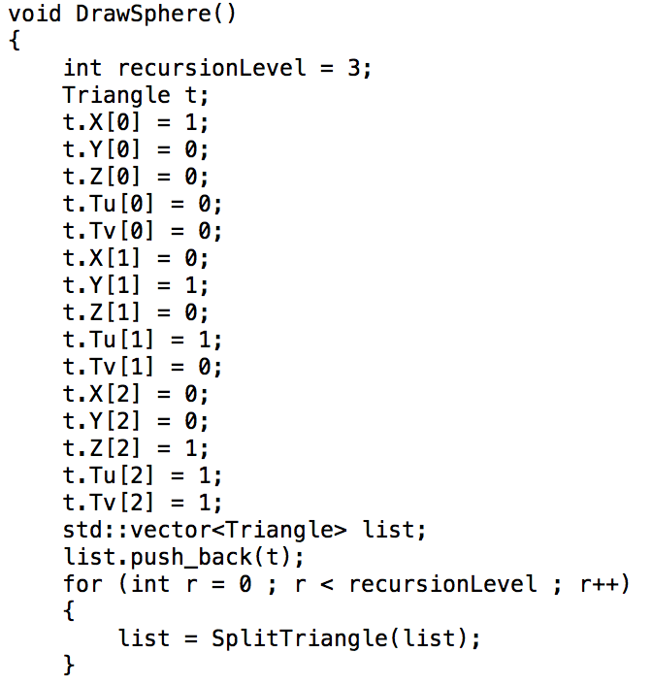
Need to put 2D textures on our triangles…

Slide 37
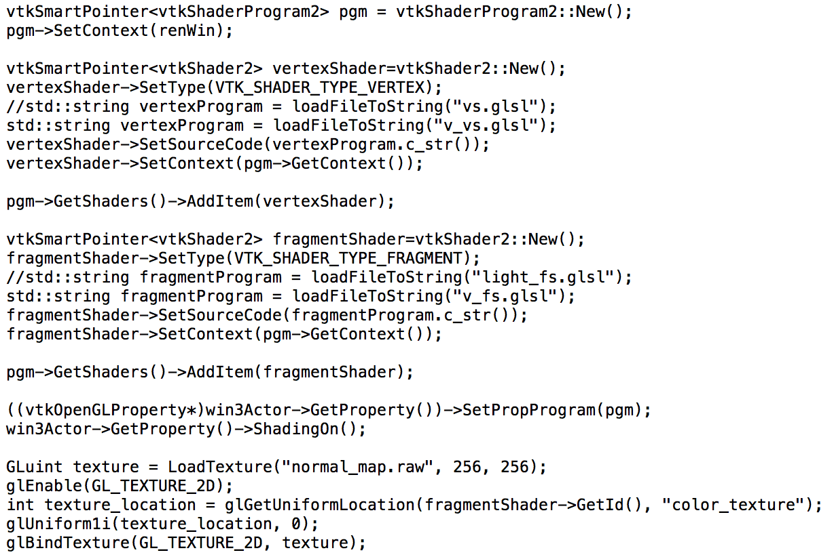
Need to set up shaders and textures…

Slide 38
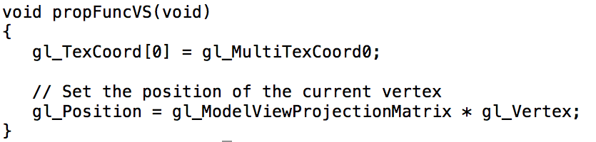
So what is the vertex shader program?...

Slide 39
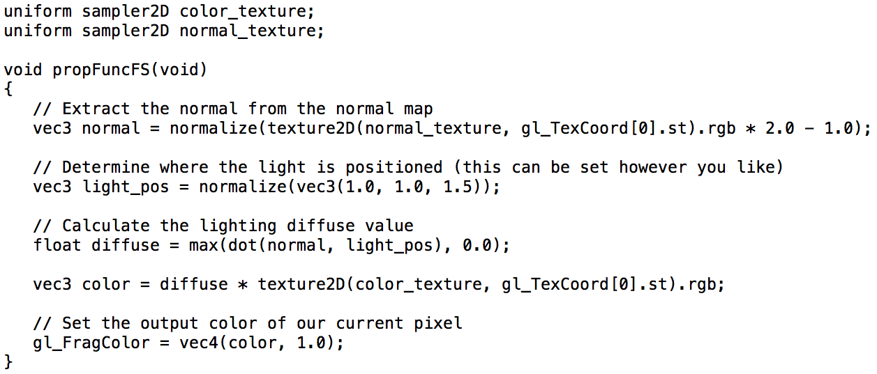
And what is the fragment shader program?...

